Slide 1
Chapter IV
Fourier Integral

Slide 2
Continuous–Time Fourier Transform
So far, we have seen periodic signals and their representation in terms of linear combination of complex exponentials.
Practical meaning:
  superposition of harmonically related complex exponentials.
How about aperiodic signals?

Slide 3
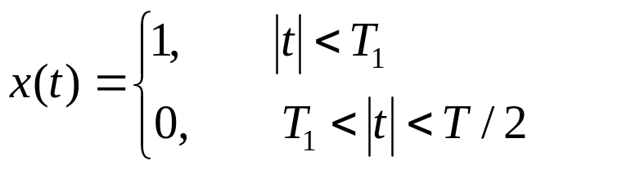







Fourier Transform Representation of Aperiodic Signals
(An aperiodic signal is a periodic signal with infinite period.)
Let us consider continuous-time periodic square wave
...
...

Slide 4
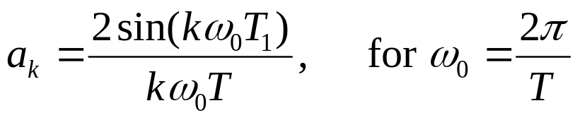
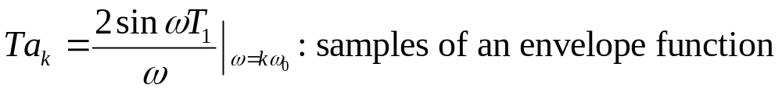
Fourier Transform Representation of Aperiodic Signals
Recall that the FS coefficients are:
Let us look at it as:

Slide 5




Fourier Transform Representation of Aperiodic Signals
as , → closer samples, faster rate!
as , periodic square wave → rectangular pulse (aperiodic signal)
, FS coefficients x T → envelope itself
→ Think of aperiodic signal as the limit of a periodic signal

Slide 6






Fourier Transform Representation of Aperiodic Signals
→ Examine the limiting behaviour of FS representation of this signal
→ Consider a signal that is of finite duration,

Slide 7








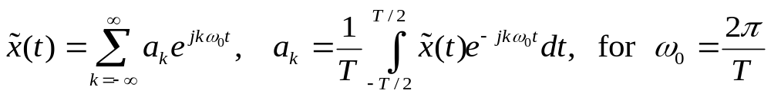
Fourier Transform Representation of Aperiodic Signals
We can construct a periodic signal out of with period
For
...
...
t
FS representation of periodic signal

Slide 8
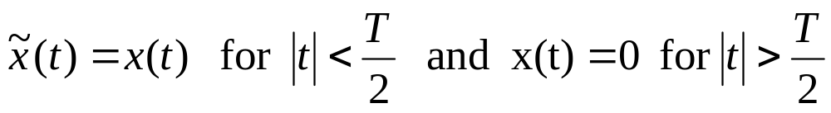
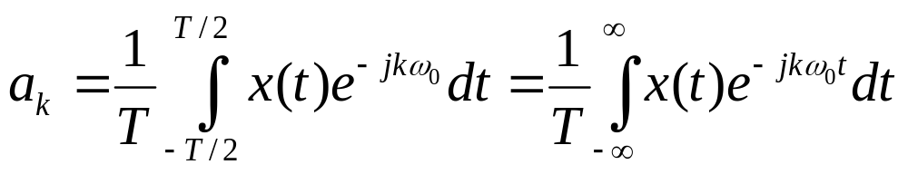

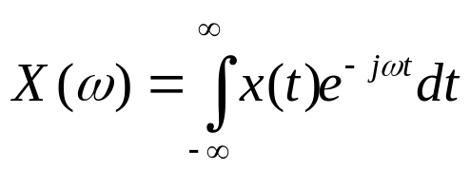
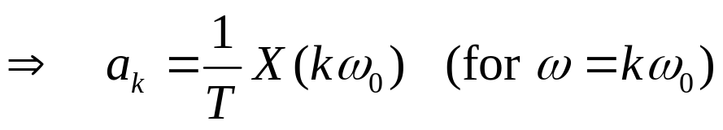
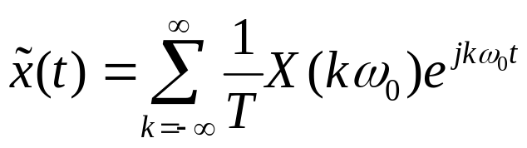
Fourier Transform Representation of Aperiodic Signals
Since
(Recall and envelope case)
Define
as the envelope of

Slide 9
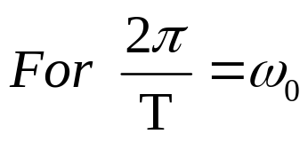
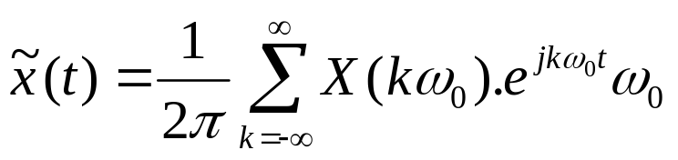

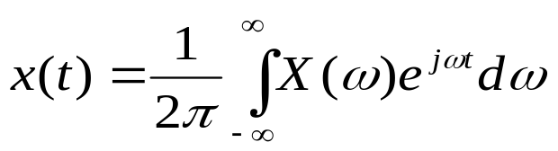
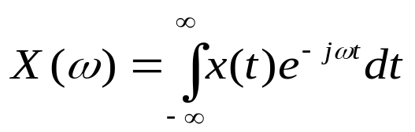
Fourier Transform Representation of Aperiodic Signals
Hence,
: inverse Fourier transform
Fourier Transform pair
: Fourier transform (spectrum)
information needed for describing x(t) as a linear combination of sinusoids

Slide 10

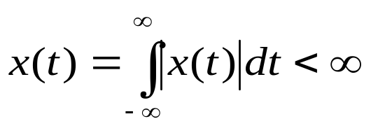
Convergence of Fourier Transform
Dirichlet conditions guarantee that
at any t
except at discontinuities (similar to periodic case).
i) x(t) is absolutely integrable,
ii) x(t) has a fiinite number of maxima and minima within any finite interval
iii) x(t) has a finite number of discontinuities within any finite interval. Further more each of these discontinuities must be finite.

Slide 11
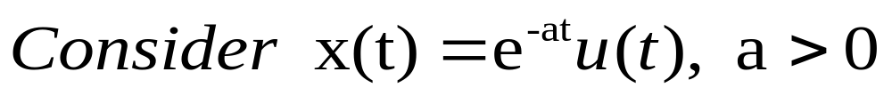
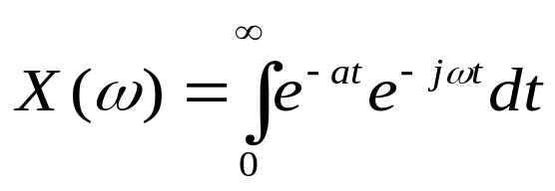
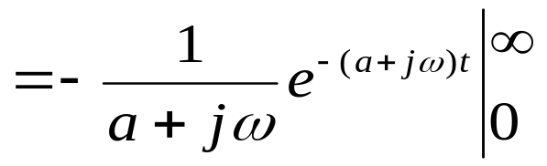
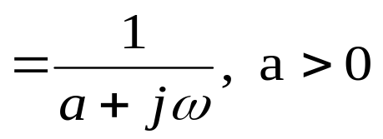
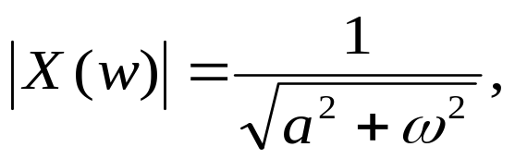
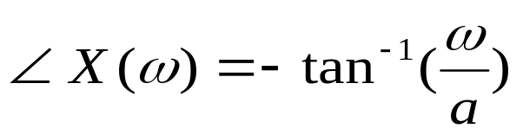



Example

Slide 12
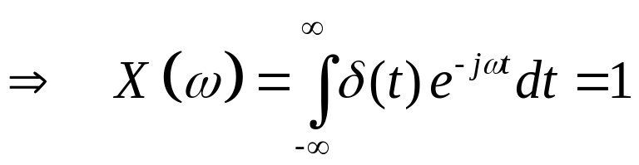

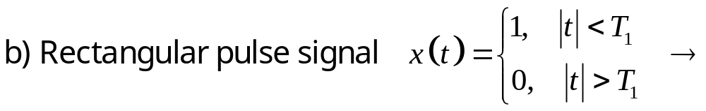
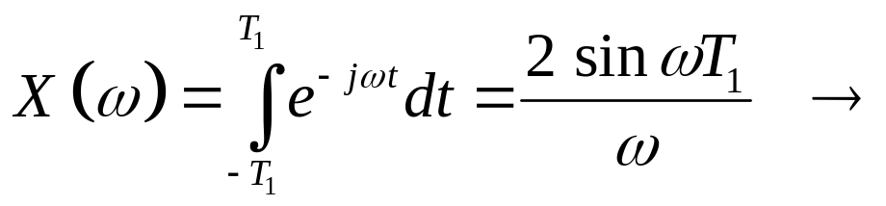

Example
x(t)
t
-T₁
T₁
2T₁
X(ω)
ω

Slide 13
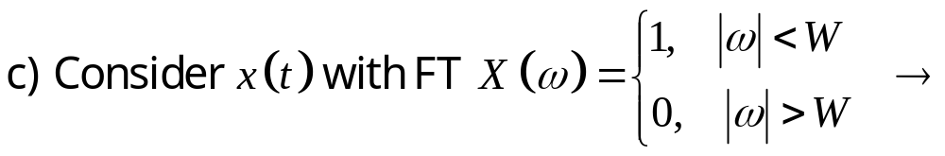
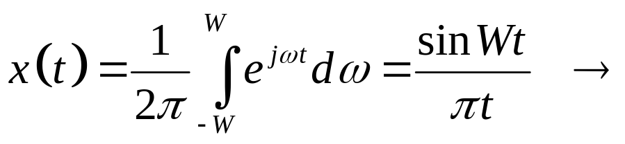

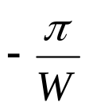

Example (cont’d)
X(ω)
ω
-W
W
x(t)
t

Slide 14
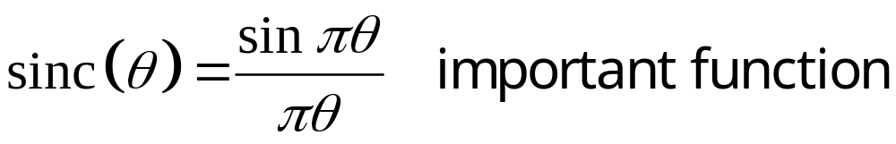
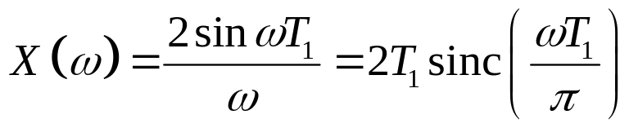


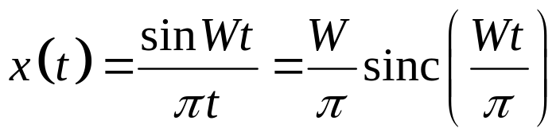


Note
x(t)
2T₁
X(ω)
t
ω
-T₁
T₁
x(t)
X(ω)
ω
t
-W
W
Narrow in Time Domain → have Broad FT!
Broad in Time Domain → Narrow FT!
(Scaling property)

Slide 15

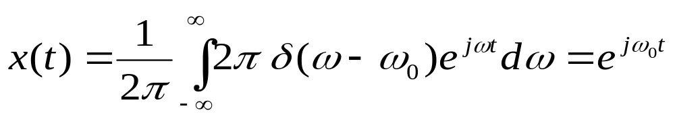
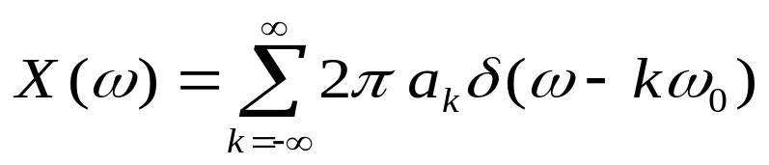
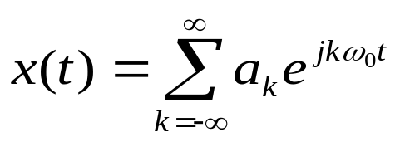
Fourier Transform For Periodic Signals
Consider a signal x(t) with Fourier Transform
(i.e., a signal impulse of area 2π at ω=ω₀)
Let us find the signal
if X(ω) is a linear combination of impulses equally spaced in frequency, i.e.,
then
: FS representation of periodic signal

Slide 16
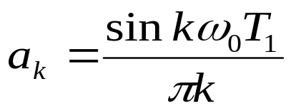
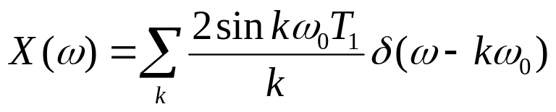
Fourier Transform For Periodic Signals
Hence, FT of periodic signal is weighted impulse train occuring at integer multiples of ω₀
Example:
a) Periodic square wave:
Recall FS coefficients of periodic
square wave (from previous chapter)

Slide 17
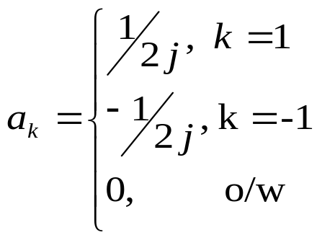



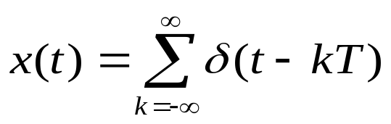
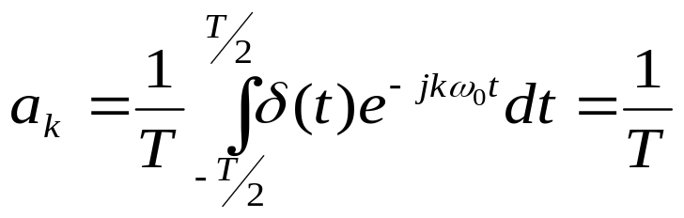
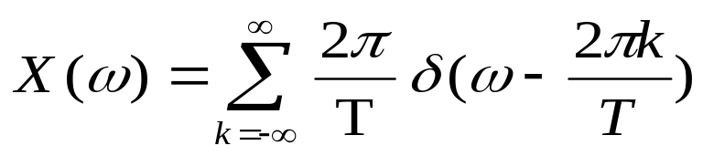
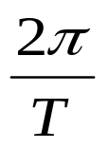
Fourier Transform For Periodic Signals
b) x(t)=sinω₀t
X(ω)
x(t)=cosω₀t
-ω₀
ω₀
c)
impulse train
FT is again impulse train in frequency domain with period

Slide 18
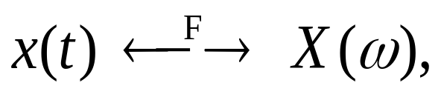
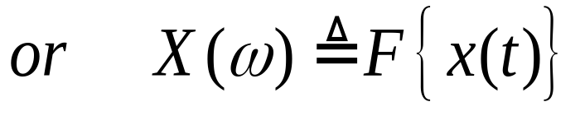
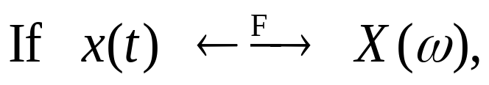
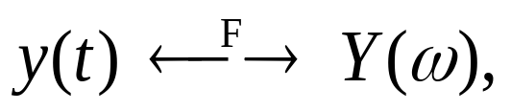
Properties of CT Fourier Transform
Notations:
1. Linearity:
Prove it as an exercise!

Slide 19

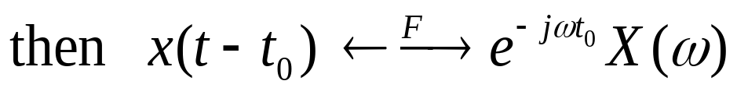
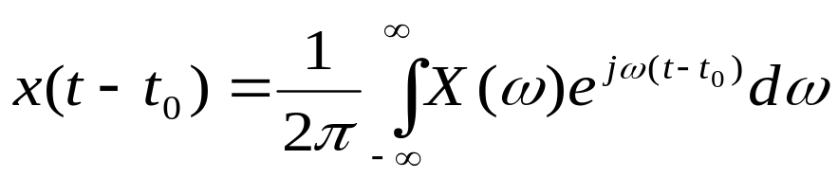
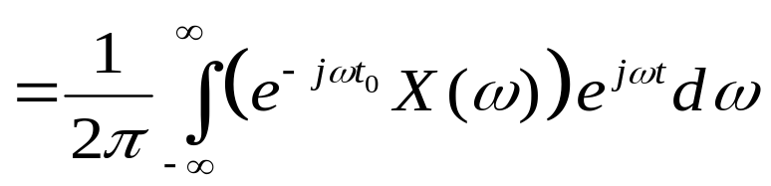
Properties of CT Fourier Transform
2. Time Shifting:
Proof:
F{x(t-t₀)}

Slide 20




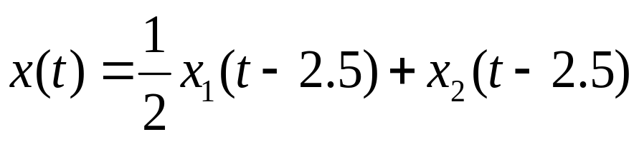
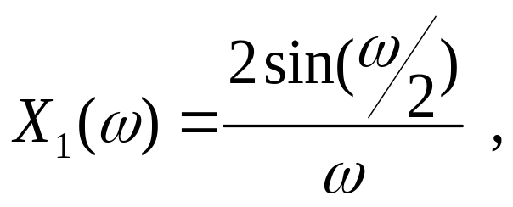
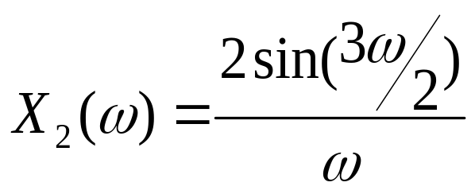
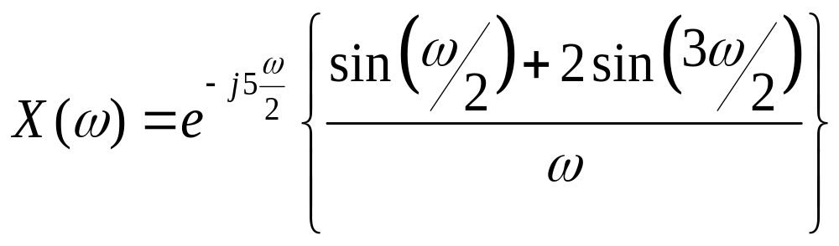
Properties of CT Fourier Transform
Example
X(t)
X₁(t)
X₂(t)
1.5
1
1
1
1
2
3
4
t
t
t
By linearity and
time-shifting properties
of FT

Slide 21






Properties of CT Fourier Transform
3. Conjugation / Conjugate Symmetry:
for real x(t)
Opp. pg. 303 for proof !
4. Differentiation & Integration:
Multiplication in frequency domain
* Important in solving linear differential equations:

Slide 22







Properties of CT Fourier Transform
Example
Consider
Take FT of both sides;
For

Slide 23





Properties of CT Fourier Transform
Example
Consider (unit step)
For

Slide 24


Properties of CT Fourier Transform
5. Time and Frequency Scaling:
(Prove using FT integral)
Remark:
- Inverse relation between time and frequency domains:
- A signal varying rapidly will have a transform occupying wider frequency band, and vice versa
-

Slide 25






Properties of CT Fourier Transform
6. Duality:
Observe the FT and inverse FT integrals:
Recall
Symmetry between the FT pairs!
In general;

Slide 26











Properties of CT Fourier Transform
Example:
By duality;
(prove it!)
Dual of the properties:
(frequency differentiation)
(frequency shifting)

Slide 27



Properties of CT Fourier Transform
7. Parseval’s Relation:
(Check the proof in Opp. pg.312)
total energy in x(t)
energy density spectrum

Slide 28





Properties of CT Fourier Transform
Convolution Property
(Additional & very important properties of FT, in terms of LTI systems)
Take FT.

Slide 29






Properties of CT Fourier Transform
Convolution Property
Convolution of two signals in time domain is equivalent to multiplication of their spectrums in frequency domain
frequency response of the system
Example:
a) Consider a CT, LTI system with
Frequency response is
Recall the time-shifting
property of FT

Slide 30


Properties of CT Fourier Transform
Convolution Property
b) Frequency-selective filtering:
achieved by an LTI system whose frequency response H(ω) passes desired range of frequencies and stops (attenuates) other frequencies, e.g.,
H(ω)
1
ω
ideal lowpass filter
-ω_{c}
0
ω_{c}
stopband
Passband
stopband

Slide 31



Properties of CT Fourier Transform
Multiplication Property
From convolution property and duality, multiplication in time domain corresponds to convolution in frequency domain.
Amplitude Modulation (multiplication of two signals) important in telecommunications !
S(ω)
Example:
A
Let s(t) has spectrum S(ω)
ω
-ω₁
ω₁
Baseband signal

Slide 32




Properties of CT Fourier Transform
Multiplication Property
P(ω)
p(t)=cosω₀t
ω
-ω₀
ω₀
R(ω)
-ω₀-ω1
-ω₀
-ω₀+ω₁
ω₀-ω₁
ω₀
ω₀+ω₁
- Information (spectral content) in s(t) is preserved but shifted to higher frequencies (more suitable for transmission)

Slide 33
Properties of CT Fourier Transform
Multiplication Property
To recover:
-Multiply r(t) with p(t)=cosω₀t
g(t)=r(t).p(t)
-Apply lowpass filter!

Slide 34
Application of Fourier Theory
Communication Systems
Definitions:
Modulation: Embedding an info-bearing signal into a second signal.
Demodulation: Extracting the information bearing signal from the second signal.
Info-bearing signal x(t): The signal to be transmitted (modulating signal).
Carrier signal c(t): The signal which carries the info-bearing signal (usually a sinusoidal signal).

Slide 35
Application of Fourier Theory
Communication Systems
Modulated signal y(t) is then the product of x(t) and c(t)
y(t)=x(t).c(t)
Objective: To produce a signal whose frequency range is suitable for transmission over communication channel. e.g.:
individual voice signals are in 200Hz-4kHz
telephony (long-distance) over microwave or satellite links in 300MHz-300GHz (microwave), 300MHz-40GHz (satellite)
Information in voice signals must be shifted into these higher ranges of frequency

Slide 36





Application of Fourier Theory Amplitude Modulation with Complex Exponential Carrier
ω_{c}: carrier frequency
Consider θ_{c}=0
From multiplication property

Slide 37


Application of Fourier Theory Amplitude Modulation with Complex Exponential Carrier
X(ω)
C(ω)
1
*
ω
ω
-ω_{m}
ω_{m}
ω_{c}
Y(ω)
1
ω
ω_{c}- ω_{m}
ω_{c}
ω_{c}+ ω_{m}
To recover x(t) from y(t):
(Shift the spectrum back)
(Demodulation)

Slide 38






Application of Fourier Theory Amplitude Modulation with Sinusoidal Carrier
x(t)
y(t)
For θ_{c}=0 ,
y(t)=x(t)cosω_{c}t ,
Y(ω)
ω
-ω_{c}- ω_{m}
-ω_{c}
-ω_{c}+ ω_{m}
ω_{c}- ω_{m}
ω_{c}
ω_{c}+ ω_{m}

Slide 39

Application of Fourier Theory Amplitude Modulation with a Sinusoidal Carrier
To recover x(t) from y(t), the condition ω_{c}>ω_{m} must be satisfied! Otherwise, the replicas will overlap.
Example:
X(ω)
Y(ω)
1
1
-ω_{m}
ω_{m}
-ω_{m}- ω_{c}
-ω_{c}
ω_{c}
ω_{m}+ ω_{c}

Slide 40





Application of Fourier Theory Demodulation for Sinusoidal Amplitude Modulation
→ To recover the information-bearing signal x(t) at the receiver
Synchronous Demodulation:
Transmitter and receiver are synchronized in phase
x(t) can be recovered by modulating y(t) with the same sinusoidal carrier and applying a lowpass filter.
(need to get rid of the 2nd term in RHS)

Slide 41


Application of Fourier Theory Demodulation for Sinusoidal Amplitude Modulation
Y(ω)
ω
-ω_{c}
ω_{c}- ω_{m}
ω_{c}
ω_{c}+ ω_{m}
C(ω)
ω
-ω_{c}
ω_{c}
W(ω)
H(ω)
ω
2ω_{c}
-ω_{m}
ω_{m}
2ω_{c}- ω_{m}
2ω_{c}
Apply lowpass filter (H(ω)) with a gain of 2 and cutoff frequency (ω_{co})
ω_{m}<ω_{co}<2ω_{c}-ω_{m}

Slide 42


Application of Fourier Theory Demodulation for Sinusoidal Amplitude Modulation
y(t)
In general,
x(t)
H(ω)
w(t)
2
x(t)
y(t)
-ω_{co}
ω_{co}
lowpass filter

Slide 43



Application of Fourier Theory Demodulation for Sinusoidal Amplitude Modulation
Assume that modulator and demodulator are not synchronized;
θ_{c} : phase of modulator
φ_{c} : phase of demodulator

Slide 44




Application of Fourier Theory Demodulation for Sinusoidal Amplitude Modulation
When we apply lowpass filter
output x(t)
output 0
must be maintained over time
requires synchronization

Slide 45
Application of Fourier Theory Demodulation for Sinusoidal Amplitude Modulation
Asynchronous Demodulation:
→ Avoids the need for synchronization between the modulator and demodulator
→ If the message signal x(t) is positive, and carrier frequency ω_{c} is much higher than ω_{m} (the highest frequency in the modulating signal), then envelope of y(t) is a very close approximation to x(t)
envelope
y(t)
t

Slide 46


Application of Fourier Theory Demodulation for Sinusoidal Amplitude Modulation
Envelope Detector :
→ to assure positivity add DC to message signal, i.e., x(t)+A > 0
→ x(t) vary slowly compared to ω_{c} (to track envelope)
y(t)=(A+x(t)) cosω_{c}t
x(t)
half-wave rectifier!
A
+
+
y(t)
C
R
w(t)
cos ω_{c}t
–
–
Tradeoff : simpler demodulator, but requires transmission of redundancy (higher power)

Slide 47
Application of Fourier Theory
Single-Sideband (SSB) Sinusoidal Amplitude Modulation
For ω_{m} is the highest frequency in x(t), total bandwidth of the original signal 2ω_{m}.
X(ω)
→ 2ω_{m}
ω_{m}
With sinusoidal carrier: spectrum shifted to ω_{c} and -ω_{c} → twice bandwidth is required.
Y(ω)
→ 4ω_{m}
-ω_{c}
ω_{c}
→ Redundancy in modulated signal!
→ Solution: Use SSB modulation

Slide 48
Application of Fourier Theory
Single-Sideband (SSB) Sinusoidal Amplitude Modulation
X(ω)
ω_{m}
Y(ω)
(DSB)
-ω_{c}
ω_{c}
ω_{c} +ω_{m}
upper sideband
lower sideband
lower sideband
upper sideband
Y_{U}(ω)
Spectrum with upper sidebands
(SSB)
-ω_{c}
ω_{c}
Y_{L}(ω)
(SSB)
Spectrum with lower sidebands
-ω_{c}
ω_{c}

Slide 49
Application of Fourier Theory
Single-Sideband (SSB) Sinusoidal Amplitude Modulation
For upper sidebands: Apply y(t) to a sharp cutoff bandpass/highpass filter.
H(ω)
y(t)
y_{U}(t)
-ω_{c}
ω_{c}
Y(ω)
Y_{U}(ω)
-ω_{c}
ω_{c}
-ω_{c}
ω_{c}

Slide 50

Application of Fourier Theory
Single-Sideband (SSB) Sinusoidal Amplitude Modulation
For lower sidebands: Use 90º phase-shift network.
cos ω_{c}t
(Trace the operation as exercise!)
y₁(t)
x(t)
y(t)
y₂(t)
Y_{L}(ω)
x_{p}(t)
-ω_{c}
ω_{c}
sin ω_{c}t
AM-DSB/WC
AM-DSB/SC
,
AM-SSB/WC
AM-SSB/SC
: AM, Double (Single) SB, with carrier
: AM, Double (Single) SB, suppressed carrier

